Slide 1
Rules of Graphing
Lecture 2 Biology 364/664 Bucknell University
Prof. Ken Field

Slide 2
The Analysis of Biological Data Whitlock & Schluter
Show the data.
Make patterns in the data easy to see.
Represent magnitudes honestly.
Draw graphical elements clearly.

Slide 3
Tufte’s Rules
Show Your Data
Use Graphics
Avoid Chartjunk
Utilize Data-ink
Use Labels
Utilize Micro/Macro
Separate Layers
Use Multiples
Utilize Color
Understand Narrative
Dr. Edward Rolf Tufte

Slide 4
Graphical Integrity
The representation of numbers, as physically measured on the surface of the graph itself, should be directly proportional to the numerical quantities represented
Clear, detailed and thorough labeling should be used to defeat graphical distortion and ambiguity. Write out explanations of the data on the graph itself. Label important events in the data.
Show data variation, not design variation.
The number of information carrying (variable) dimensions depicted should not exceed the number of dimensions in the data. Graphics must not quote data out of context.

Slide 5
Data ink principles
Above all else show data.
Maximize the data-ink ratio.
Erase non-data-ink.
Erase redundant data-ink.
Revise and edit
A figure with a high data-ink ratio

Slide 6
Locust Data as example
```r
locustData <- read.csv(url("http://whitlockschluter.zoology.ubc.ca/wp-content/data/chapter02/chap02f1_2locustSerotonin.csv"))
summary(locustData)
```
```
serotoninLevel treatmentTime
Min. : 3.200 Min. :0
1st Qu.: 4.675 1st Qu.:0
Median : 5.900 Median :1
Mean : 8.407 Mean :1
3rd Qu.:11.475 3rd Qu.:2
Max. :21.300 Max. :2
```

Slide 7
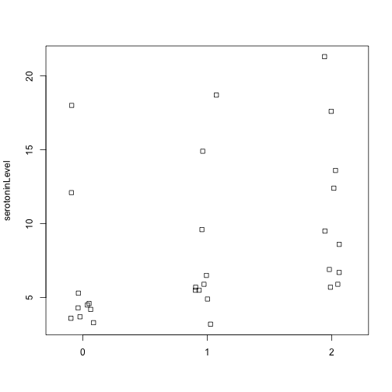
```r
stripchart(serotoninLevel ~ treatmentTime, data = locustData, method = "jitter",
vertical = TRUE)
```
Strip chart of serotonin levels in the central nervous system of desert locusts that were experimentally crowded for 0 (the control group), 1, and 2 hours.

Slide 8
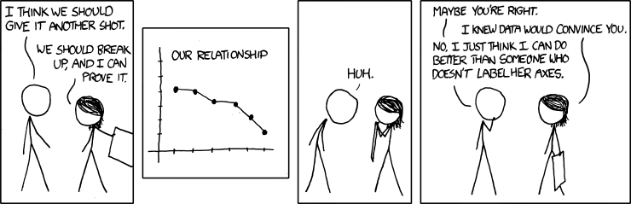
Label your axes
from https://xkcd.com/833/

Slide 9
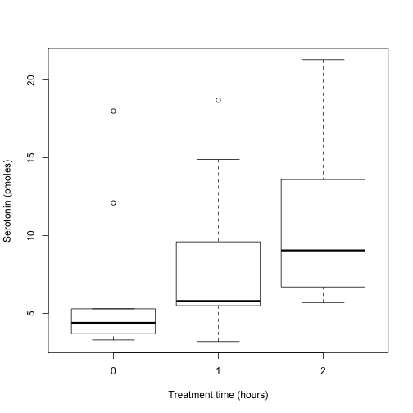
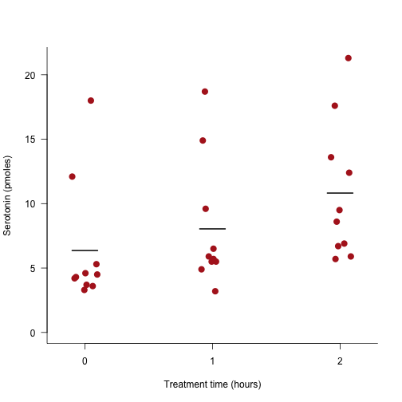

Slide 10
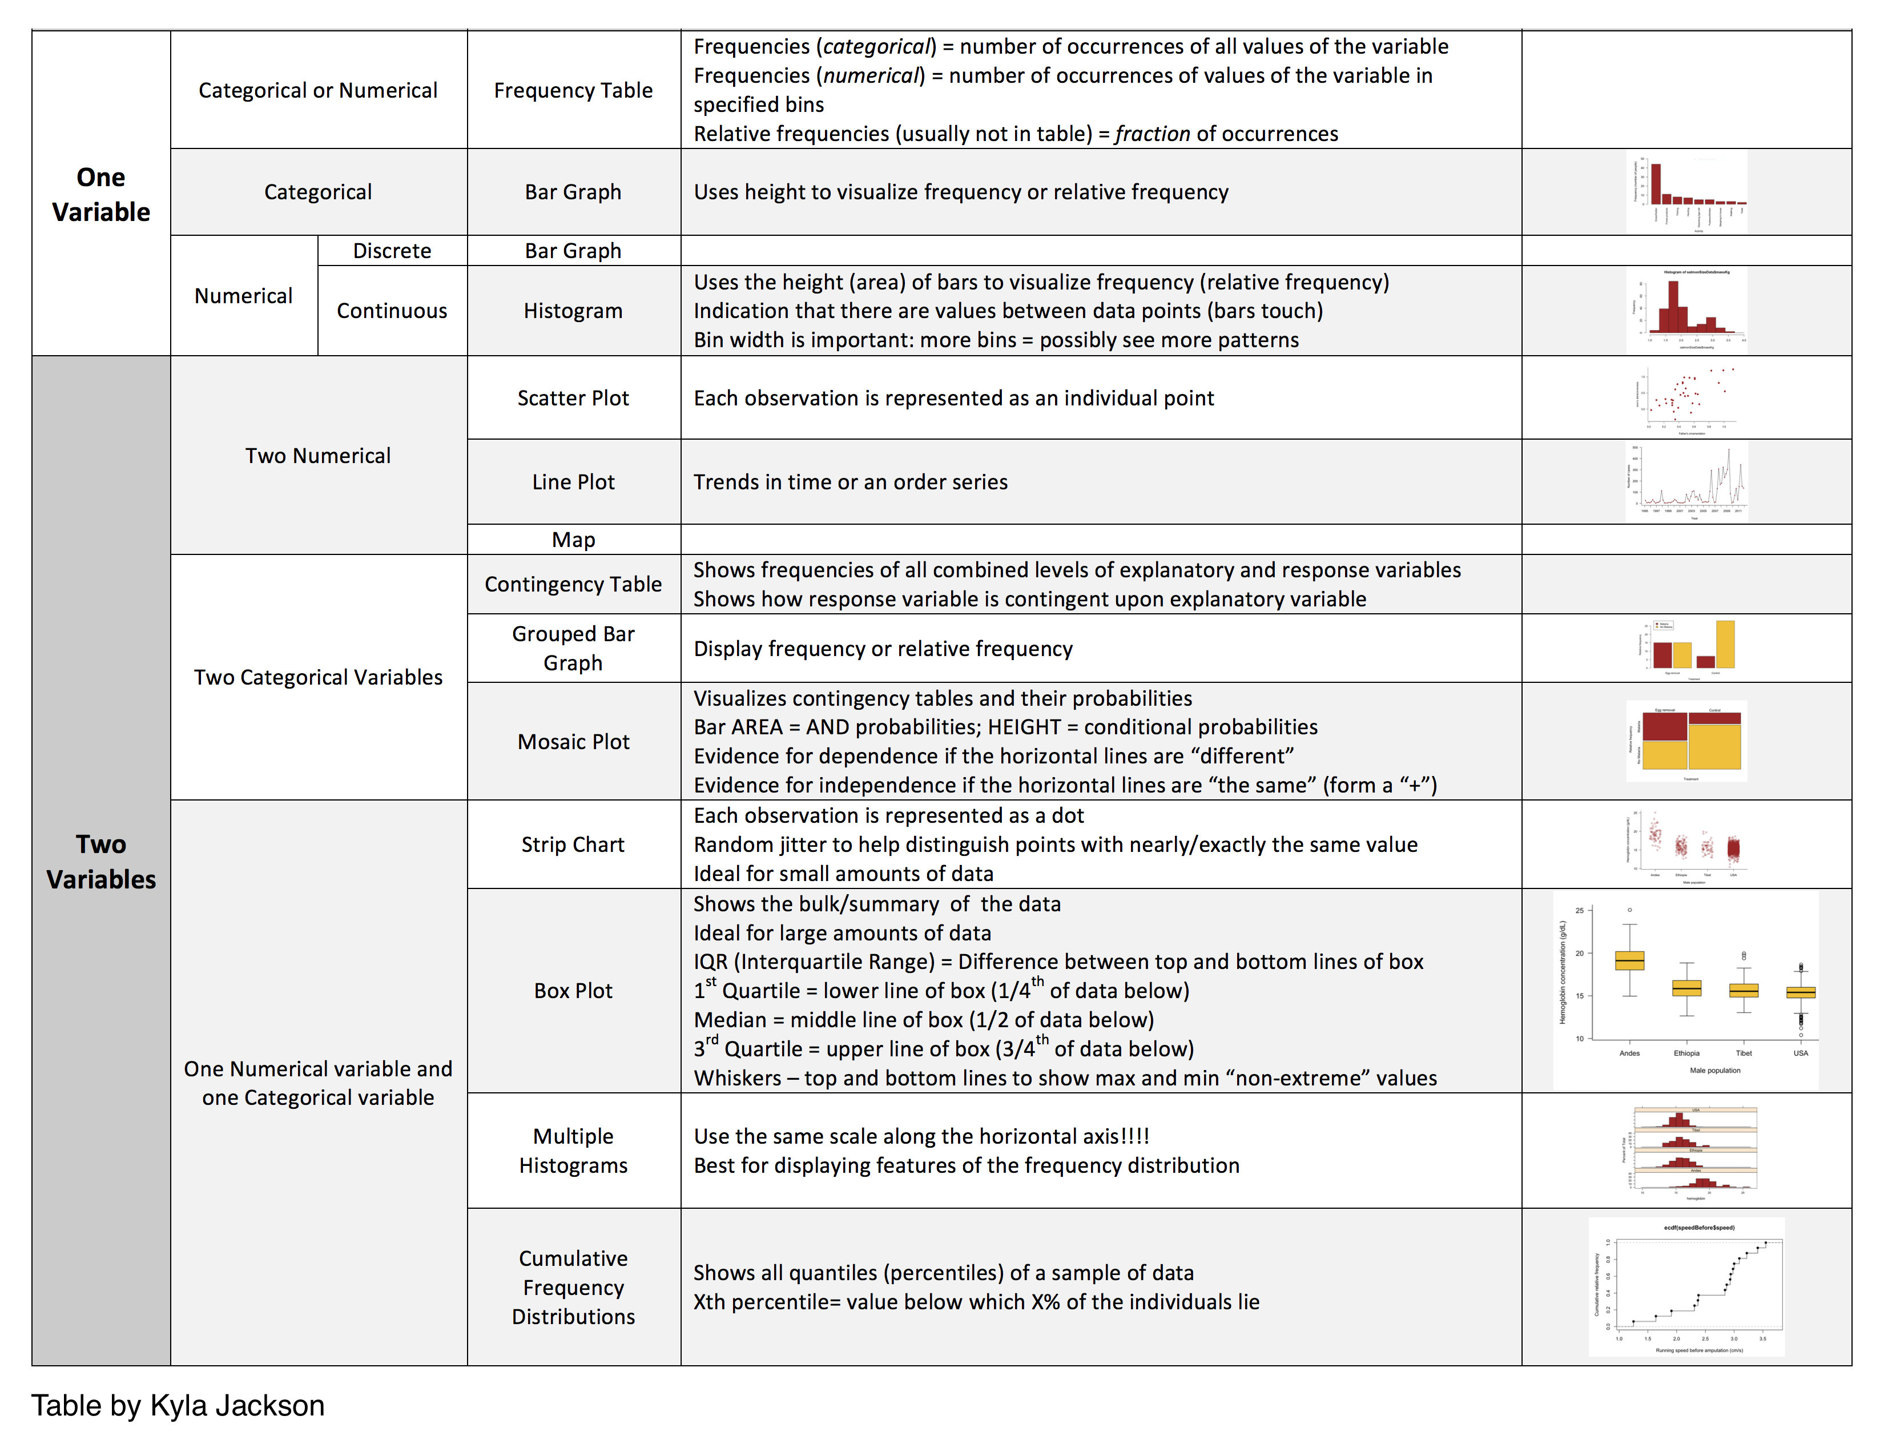
Use the correct graph for your data

Slide 11
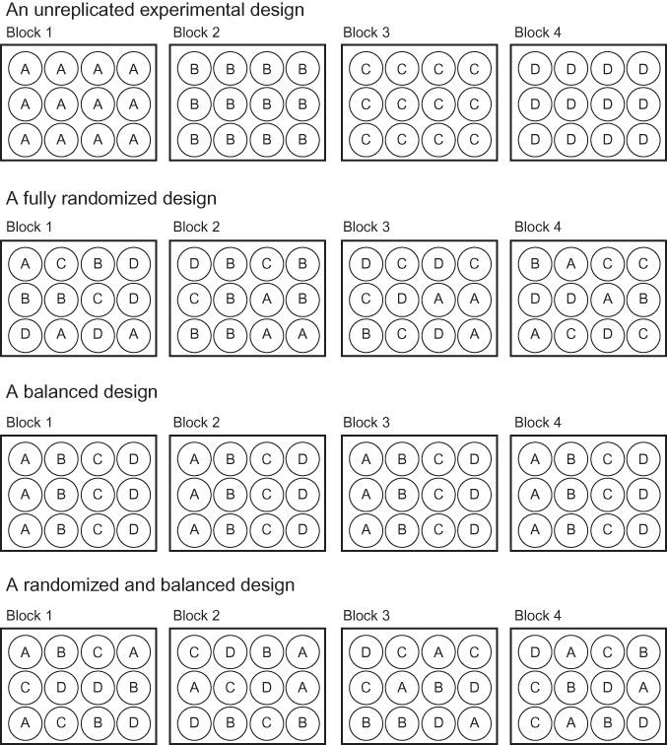
Experimental Design

